Slide 1
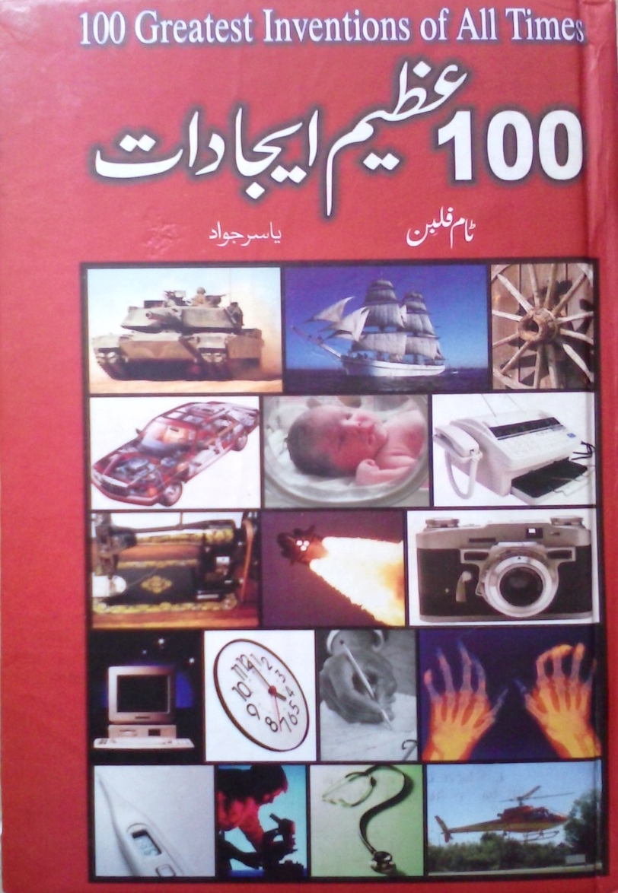
S.M MUJTABA RC # 7

Slide 2
CONTENTS
WHEEL
LIGHT BULB(Incandsecent bulb)
PRINTING PRESS
TELEPHONE
RADIO
ATOM BOMB
PLUMBING
WELDING MACHINE

Slide 3
WHEEL
35000 (B.C.)
Larkhtay howay darkht k tanay
Rathon(4 wheel cart) 2000 (B.C.)
Two wheel
Travelling
Need raised
Romans made streets which provides flavour to wheels and their popularity
Now a days Clock microscopic gears are made up on the basis of wheels

Slide 4
LIGHT BULB(Incandsecent bulb)
Thomas Edison
1880 patent
Azeem mojad(inventor)
Physical appearance
Kaar amad bulb
Lighten America
Filament problem - 1600 materials
First use Platinium 10 mins
Carbon
Today tungstun

Slide 5
PRINTING PRESS (CONT…..)
Insaani tareekh ka aghaaz hi printing say waabasta hy
Azeem logon k nazaryaat kitaab
Pheli martaba haath say likhi gae kitaab Isamic books thn
Lakri k blocks pr obhray huroof say printing k aghaaz multa hy

Slide 6
Gotumberg nah sb say phelay metals ki madad say huroof - reliable and durable
Gotumberg Bible sab say pheli sb say zyada shaya honay wali ashaa’at
revolution in education and information

Slide 7
TELEPHONE
Alexandar Graham bell
1854
Oersted
Faraday
Graham sharp minded

Slide 8
RADIO
Markoni
Italy
He succeed but in short distance
Gov. does not support
London
1898 patient
1899 31miles
1901 2000 miles
1924 scientific approach

Slide 9
PENCIL
1564
Namaloom fard
Graphite
Holder
16 century par
19 century dhaati nib
1884 fountain pen patient

Slide 10
PAPER
4000 (B.C.)
Mojoda shakal 105(B.C.)
1852 from wood
Phelay school mein slait ab paper
Paper

Slide 11
ATOM BOMB
Tareekh saaz mor
1954 on japan
Pearl Harbour
Fission
1 micro second
First bomb Maxico(Trinty)
Fat bomb

Slide 12
PLUMBING
Falak boos emarat
Romans
Lead
1854 harmful effects of lead
13 century
Euorope

Slide 13
TEER KAMAAN
Shikaar
Self defence
Stone age
1500 betterment
Modern time made of fiber or aluminium

Slide 14
WELDING MACHINE
Greatest manufacturing tool
Two parts permanently joint
Water
History (gold parts)
Bronze age
1836 gas welding
1877 electric arc welding
Now a days laser welding

